Slide 1

L1.3 HW/SW Platforms, Ethics
Zonghua Gu, Umeå University
Nov. 2023

Slide 2
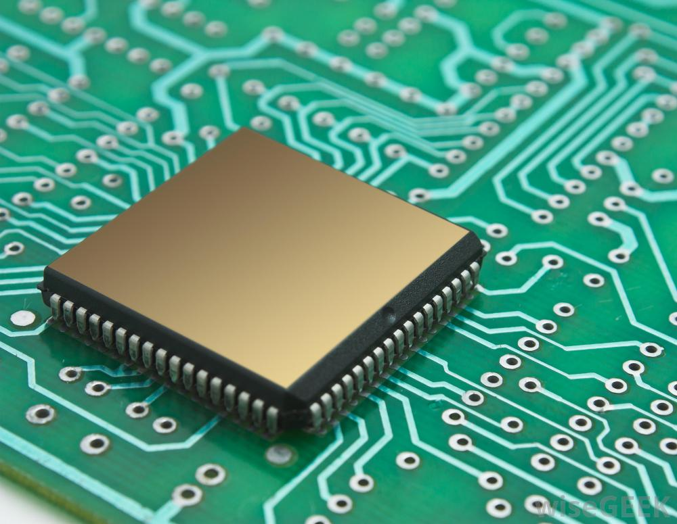
Hardware Platforms

Slide 3
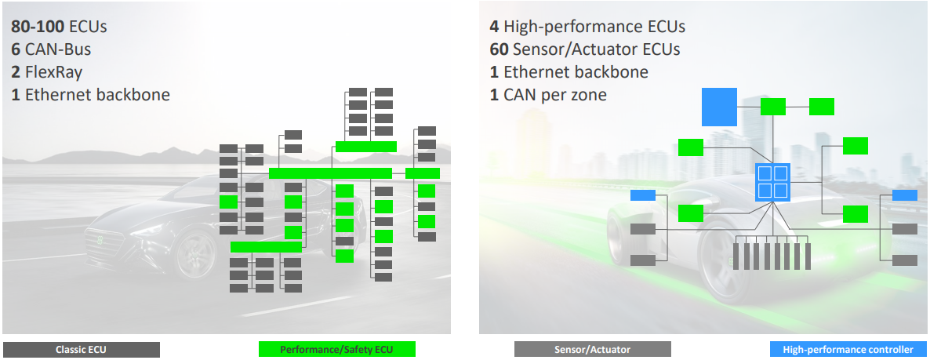
Evolution of Automotive E/E Architecture
From many (~80-100) distributed and networked Electronic Control Units (ECUs) to a few (~4) high-performance ECUs with massive computing power, and large number of (~60) small ECUs for interfacing with sensors and actuators

Slide 4
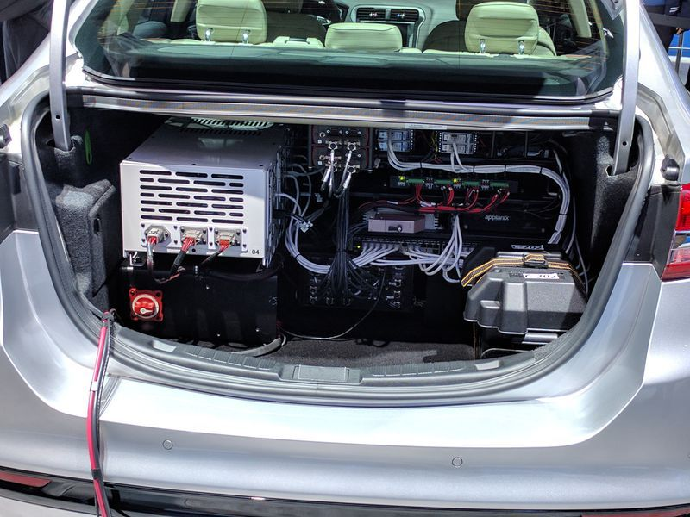


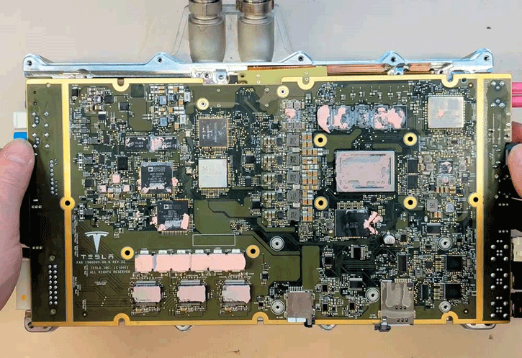
Automotive E/E Architecture Trends
Automotive E/E architecture trends:
HW platform consolidation
Centralized architecture with a few ECUs helps simplify system architecture, reduce network load, and improve system reliability
HW platform miniaturization
A trunkful of electronics hinders consumer acceptance and mass deployment
System-on-Chip technology helps to achieve high-performance computing with small form factor and low power consumption
Significant HW resource constraints in terms of processor speed, memory size, and network bandwidth
Level of constraints depends on the application context, e.g., mobile robots and consumer drones have more severe constraints than passenger cars
Computing Workload
Where do I put my groceries?
Trunk of an Experimental AV from Ford (2017)
In-Vehicle HW platform
Tesla’s FSD Processor (2022)

Slide 5
Design Objectives vs. HW Constraints
Design Objectives
Safety
System failures may be deadly
Hard real-time
Deadline misses may compromise safety
Security
Malicious attacks may compromise safety
HW Constraints
Size/Weight
Must be compact and lightweight (cannot have a trunkful of electronics)
Power consumption
Power consumption of electronics (sensors and computing hardware) for AD may be 100x that of a vehicle with regular ADAS. This drains battery and implies increased fuel consumption or reduced range for EVs
Cost
Important for mass deployment
Cost of electronics in an experimental AV often exceeds cost of the original vehicle.

Slide 6
SoC Hardware for AVs
The most compute-intensive workload is Deep Learning inference
Many vendors provide SoC (System-on-Chip) products that integrate CPU cores with specialized computational engines for Deep Learning:
GPU (Graphics Processing Unit)
NVIDIA is the only serious player
Other GPU venders, e.g., AMD, ARM, Intel, focus on computer graphics instead of general-purpose computing (GPGPU)
FPGA (Field-Programmable Gate Arrays)
Xilinx, Intel Altera
ASIC (Application-Specific Integrated Circuit)
An explosion of specialized ASICs for Deep Learning in recent years, with hundreds of companies and products ranging from high-performance to embedded
DSP (Digital Signal Processor)
Mainly for image preprocessing, e.g., products from Texas Instruments

Slide 7
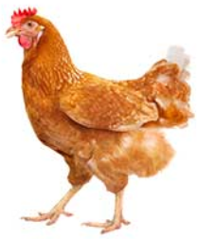
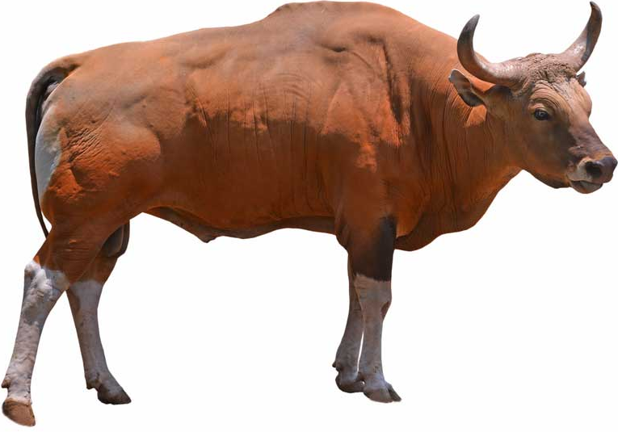
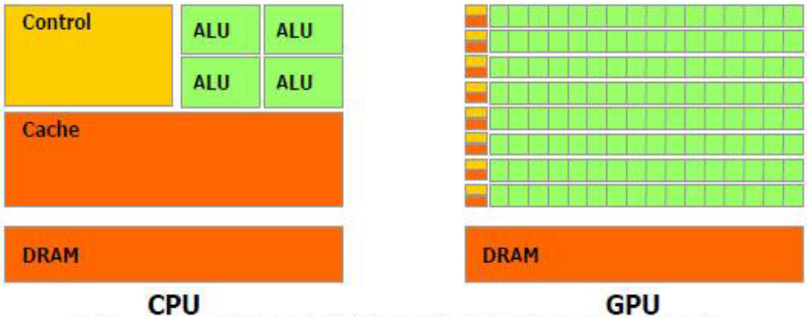
CPU vs. GPU/FPGA/ASIC
CPU is designed for general-purpose workloads
GPU has much simpler control logic than CPU, hence has more computational elements (Arithmetic Logic Units)
Specialized for highly-parallel workloads, e.g., matrix-multiply, which is a core operation in Deep Learning training and inference
Similarly for FPGA and ASIC
CPU (2 oxen)
GPU (1024 chickens)
“If you were plowing a field, which would you rather use? 2 oxen, or 1024 chickens?” S. Cray.

Slide 8
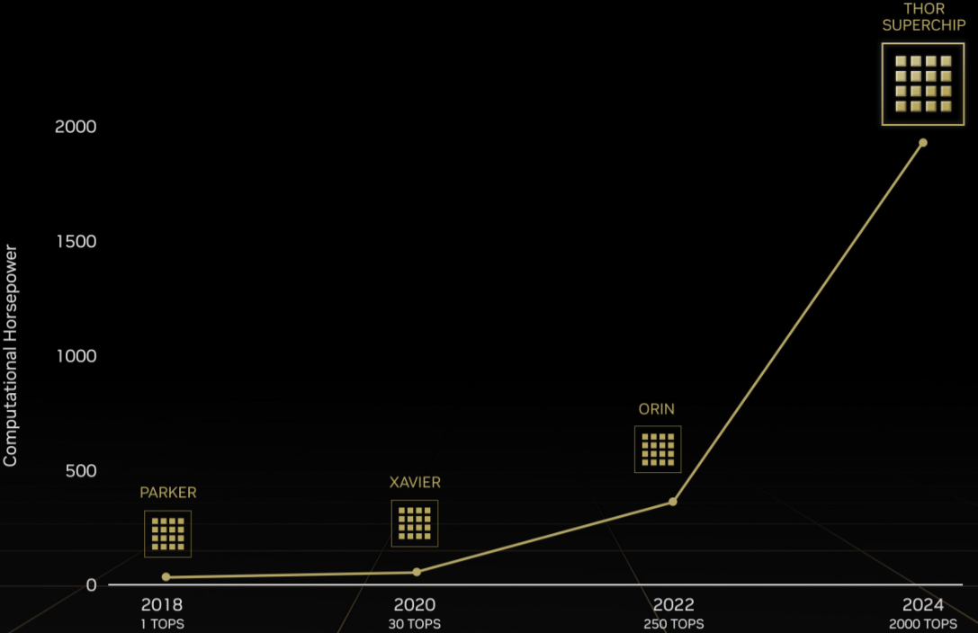
NVIDIA DRIVE GPU-based HW Platform
A family of products, ranging from the low-end Parker to the latest high-end THOR with 2000 TOPS (Tera Operations Per Second)
Besides CPU and GPU cores, also includes NVDLA (NVIDIA Deep Learning Accelerator), an ASIC for Deep Learning inference

Slide 9
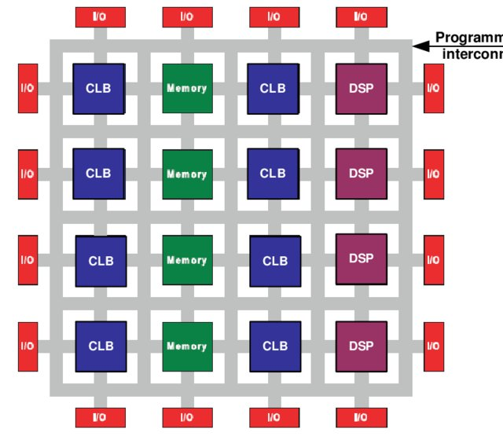
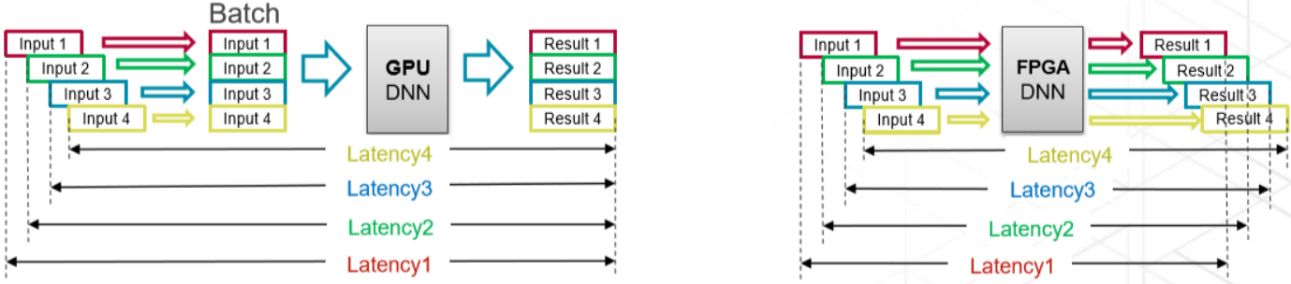
FPGA
FPGA is reprogrammable hardware, consisting of an array of Configurable Logic Blocks (CLBs) and interconnections which can be configured at design time or runtime. FPGA has advantages over GPU for Deep Learning inference tasks
GPU performs computation in batches for efficient exploitation of SIMD (Single Instruction, Multiple Data) computation model
This is ideally suited for training tasks, with well-known algorithms such as Stochastic Gradient Descent with mini-batches
But not ideal for inference tasks
Larger batch size leads to high throughput, but also high and nondeterministic latency for each data item
Smaller batch size leads to low computation efficiency
FPGA can perform “batch-less” inference
Low and deterministic latency for any batch size

Slide 10
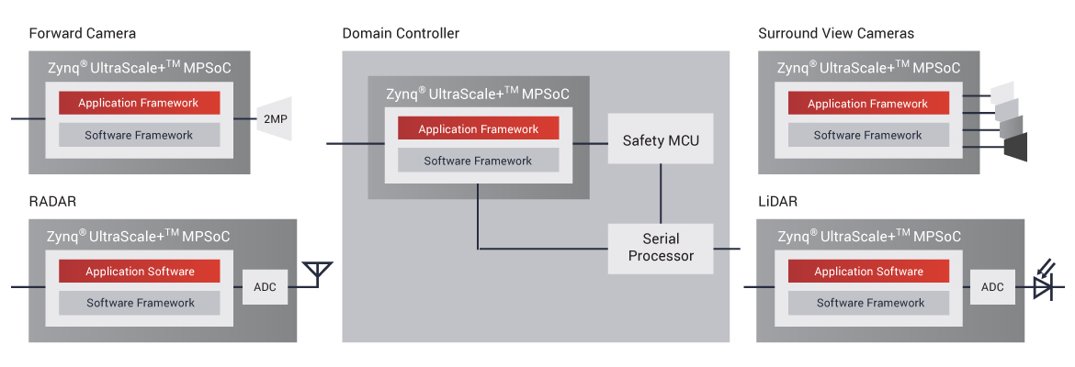
FPGA for Automotive
FPGAs can be integrated into smart sensors (camera, Lidar, radar), or serve as central compute engine in domain controller or AD computer
Xilinx FPGAs have 90% market share in Lidar signal processing
Intel went into the automotive market, with acquisition of Altera in 2015
https://www.xilinx.com/applications/automotive/automated-driving.html

Slide 11
ASIC
ASICs for Deep Learning are often called Neural Processing Units or AI accelerators
ASICs, thanks to dedicated circuit design, may achieve up to 10x in computation efficiency and power consumption compared to CPU/GPU, and less dramatic, but still significant improvement compared to FPGA. The drawback is loss of programmability and flexibility.
Almost every chip vendor provides some kind of AI accelerator, e.g. Google’s Tensor Processing Unit (TPU)

Slide 12
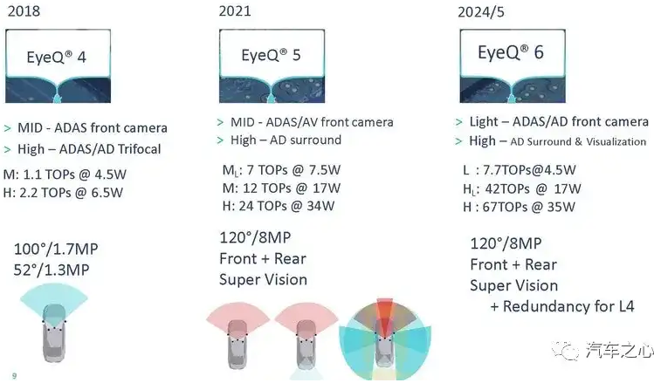
MobileEye EyeQ Series
ASICs for computer vision

Slide 13
Telsa AutoPilot HW Evolution
2014~2016: HW1 based on Mobileye EyeQ3
2016~2019: HW2 based on NVIDIA DRIVE PX2
2019~2023: HW3 FSD processor
2023~now: HW4 FSD processor
 | HW Platform | Processor Cores | Sensor Configuration
HW1 | Mobileye EyeQ3 | NVIDIA Tegra 3 | 2 cameras (front and back) 1 Radar 12 ultrasonic sensors
HW2 | NVIDIA DRIVE PX2 | 1 NVIDIA Pascal GPU, 2 NVIDIA Parker SoCs, 2 Infineon TriCore CPUs | 8 cameras 1 Radar 12 ultrasonic sensors
HW3 | FSD | NPU | 8 cameras 1 Radar 12 ultrasonic sensors
HW4 | FSD | NPU | 8 cameras
Notes:
https://new.qq.com/rain/a/20230318A013I400

Slide 14
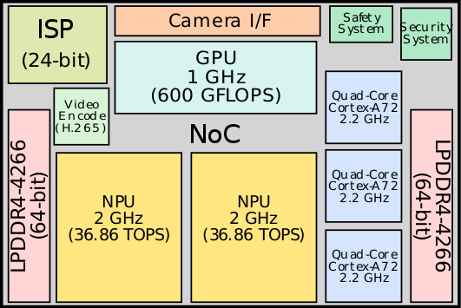
Tesla FSD Processor
HW3 incorporates 3 quad-core Cortex-A72 clusters for a total of 12 CPU cores operating at 2.2 GHz, a GPU operating at 1 GHz, 2 NPUs operating at 2 GHz
Neural Processing Unit (NPU): ASIC for Deep Learning inference
HW4 has increased computing power, shown on the right
HW3 floorplan
HW3 | HW4
CPU: Samsung Exynos-IP, 12 cores@2.2 GHz | CPU: Samsung Exynos-IP, 20 cores@2.35 GHz
2 NPUs@2.0 GHz, 36 TOPS | 3 NPUs@2.2 GHz, 50 TOPS
1 GPU@1.0 GHz | No GPU
Process: 14 nm | Process: 7nm or N4 (4nm class)
Camera resolution: 1.2MP | Camera resolution: 5MP
https://www.autopilotreview.com/tesla-hardware-4-rolling-out-to-new-vehicles/

Slide 15
Products from Automotive OEMs and Suppliers
Some companies offer integration solutions based on chip products from other vendors
Delphi/Audi zFAS (Central Driver Assistance Center)
based on NVIDIA Tegra K1 and Mobileye EyeQ3
ZF ProAI
based on NVIDIA DRIVE PX2
Bosch AI Car Computer
based on NVIDIA DRIVE AGX Xavier
Many others
Continental ADCU; Visteon DriveCore; NXP BlueBox; Renesas R-Car…

Slide 16
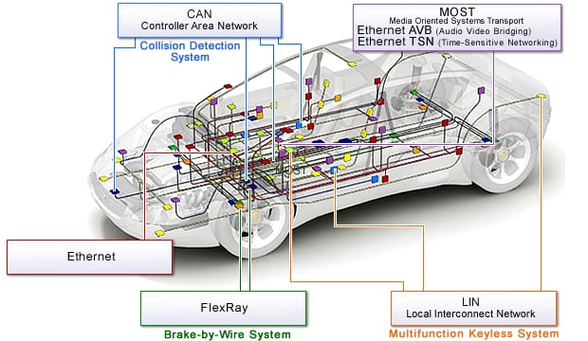
In-Vehicle Networks
Ethernet as high-bandwidth backbone network
Ethernet Time-Sensitive Networking (TSN) posed to be the dominating standard protocol
Regular Ethernet is also used for diagnostics
Media Oriented Systems Transport (MOST) for multimedia (audio/video) transmission
FlexRay for safety-critical X-by-Wire, where X stands for brake, steer, drive…
CAN (Controller Area Network) for low-bandwidth network and interfacing with sensors/actuators
LIN (Local Interconnect Network) for body electronics, e.g., door, light, rearview mirrors…
Protocol | Datarate | Applications
LIN | 10 kbps | Sensor/Actuator networking
Low-speed CAN | 125 kbps | Body and comfort
High-speed CAN | 1 Mbps | Powertrain and chassis
CAN-FD | 8 Mbps | Powertrain and chassis
FlexRay | 20 Mbps | Powertrain and chassis
MOST150 | 150 Mbps | Infotainment (audio/video)
Ethernet | 100 Mbps to 10 Gbps | Backbone network

Slide 17
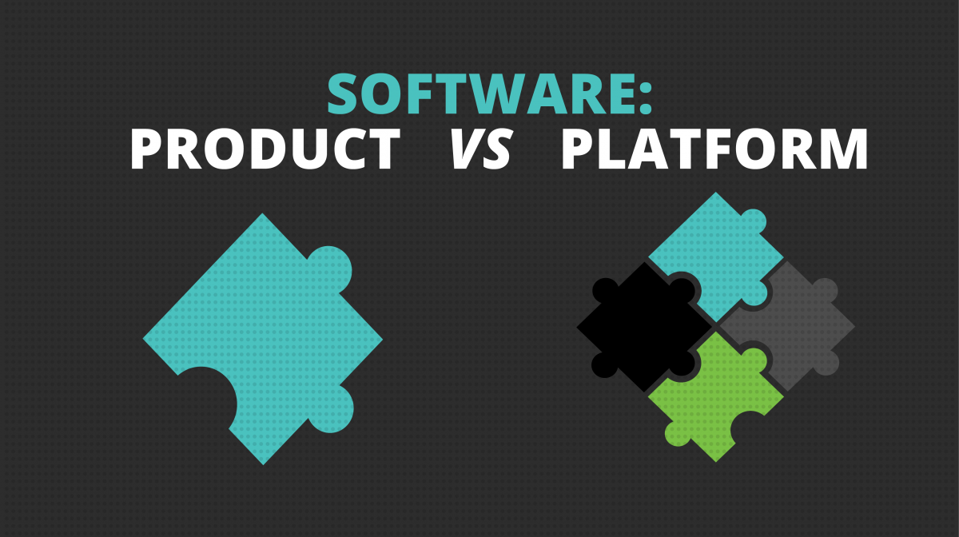
Software Platforms

Slide 18
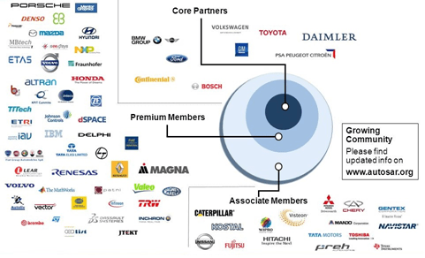
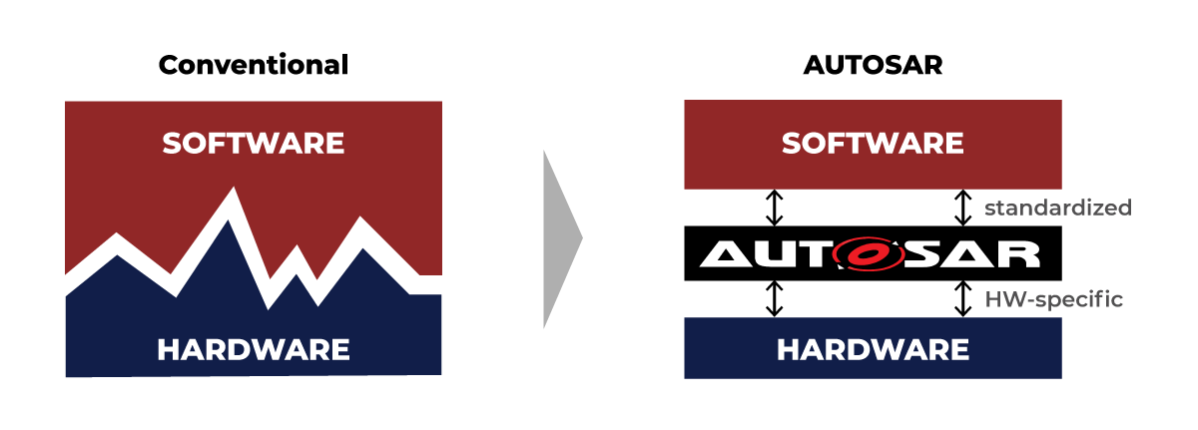
AUTOSAR Consortium
AUTomotive Open System ARchitecture (AUTOSAR) is a global development partnership of automotive interested parties founded in 2003. It pursues the objective to create and establish an open and standardized software architecture for automotive Electronic Control Units (ECUs)
https://promwad.com/news/autosar-layer-architecture

Slide 19
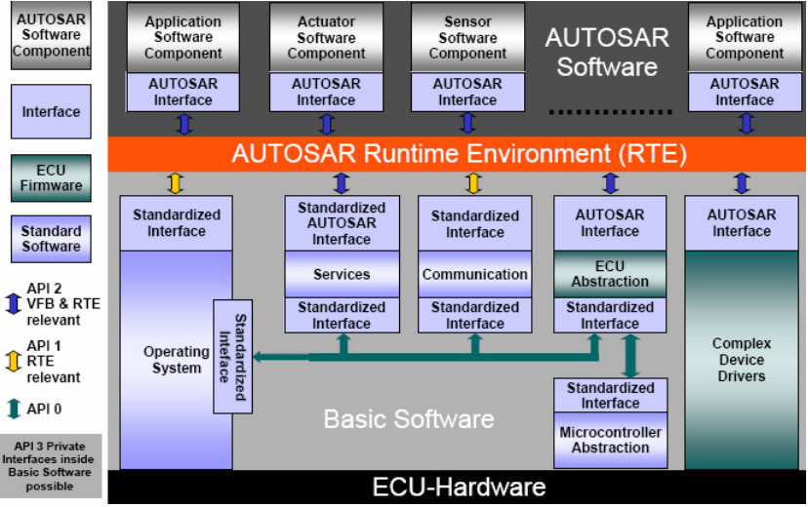
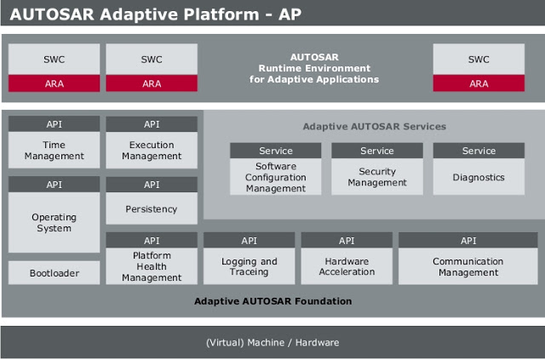
AUTOSAR Classic and Adaptive Platforms
AUTOSAR-CP (Classic Platform) is an industry standard for resource-constrained safety-critical ECUs
AUTOSAR-AP (Adaptive Platform) is an industry standard for high-performance multicore automotive ECUs
AUTOSAR-AP allows dynamic linking of services and clients during ECU runtime, which facilitates Over-the-Air (OTA) Update

Slide 20
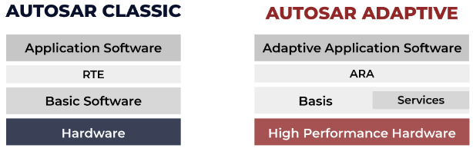
AUTOSAR Classic vs. Adaptive
 | AUTOSAR-CP | AUTOSAR-AP
Use Case | Embedded System, e.g., Engine Control, X-by-Wire | High-Performance Computing, e.g., Deep Learning-based Perception/Planning
Operating System | OSEK | POSIX
Communication | Statically Configured Signal-based (CAN, FlexRay) | Dynamically Configured Service-Oriented (SOME/IP)
Code Execution | Code executed directly from ROM | Code loaded into RAM and executed from RAM
Dynamic Updating (for OTA) | N/A | Runtime Configuration Change
API | RTE (AUTOSAR Run Time Environment) | ARA (AUTOSAR Runtime for Adaptive Applications)
Real-Time Constraints | Hard | Soft
Classic vs. Adaptive Autosar https://www.youtube.com/watch?v=xsUCcetEcSk

Slide 21
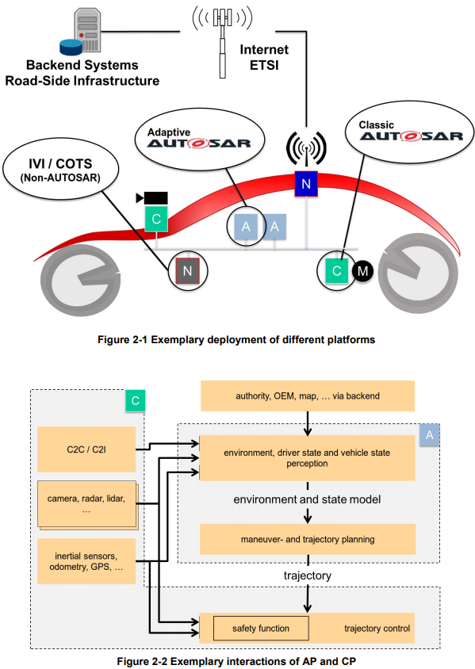
Integration of Multiple SW Platforms
AUTOSAR CP (labeled C) is used for safety-critical ECUs for low-level control and interfacing with actuators
AUTOSAR AP (labeled A) is used for high-performance AD computer.
Non-AUTOSAR (labeled N) may be Linux or Android, for non-safety-critical IVI (In-Vehicle Infotainment) and COTS (Commercial Off-the-Shelf) applications.

Slide 22
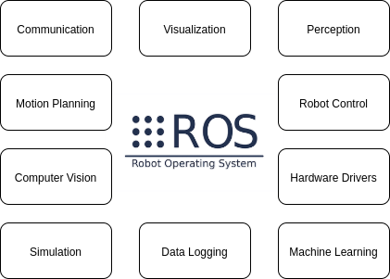
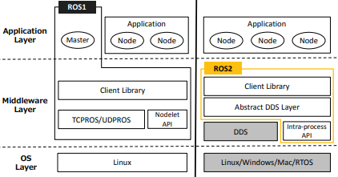
Robot Operating System (ROS)
ROS is a set of software libraries and tools for building robotic applications. Many companies use ROS to develop AVs. It uses the publish-subscribe paradigm for inter-node communication.
ROS has a Master node that provides naming and registration services to the rest of the nodes.
ROS 2 removed the Master node, and uses publish-subscribe middleware DDS (Data Distribution Service)
Since ROS uses Linux as the underlying operating system, it is difficult to pass high-level of safety certification
Maruyama Y, Kato S, Azumi T. Exploring the performance of ROS2[C], Proceedings of the 13th International Conference on Embedded Software. 2016: 1-10.

Slide 23
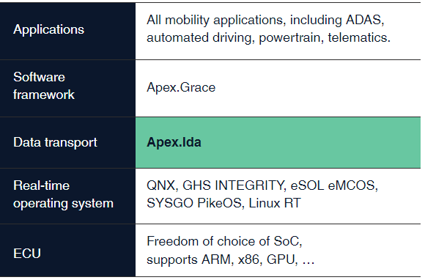
Apex.ai
“Safe and certified software framework for autonomous mobility systems.”
Certified as a Safety Element out of Context (SEooC) up to Automotive Safety Integrity Level (ASIL)-D
Choice among multiple Real-Time Operating Systems (RTOS)
https://www.apex.ai/apexida
Notes:
Hard real-time, static memory allocation (no new() or malloc()), callbacks vs. waitset, security, testing, real-time I/O logging…

Slide 24
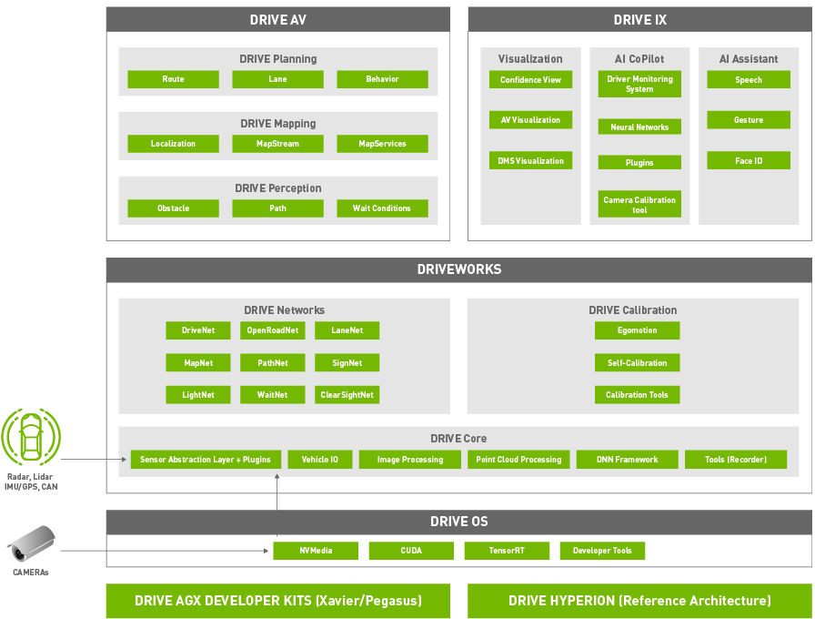
NVIDIA DRIVE Software Framework
An open-source framework for AD (only for NVIDIA hardware).
DRIVE OS is a foundational software stack consisting of an embedded Real Time OS (RTOS), hypervisor, CUDA libraries, Tensor RT, and other modules that give you access to the hardware engines.
DriveWorks SDK enables developers to implement AV solutions by providing a comprehensive library of modules, developer tools, and reference applications.
DRIVE AV provides perception, mapping, and planning modules that utilize the DriveWorks SDK.
DRIVE IX provides full cabin interior sensing capabilities needed to enable AI cockpit solution.

Slide 25
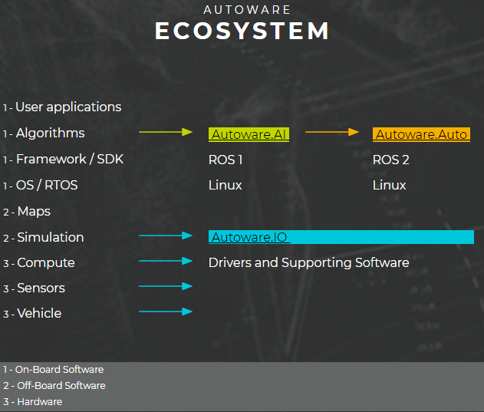
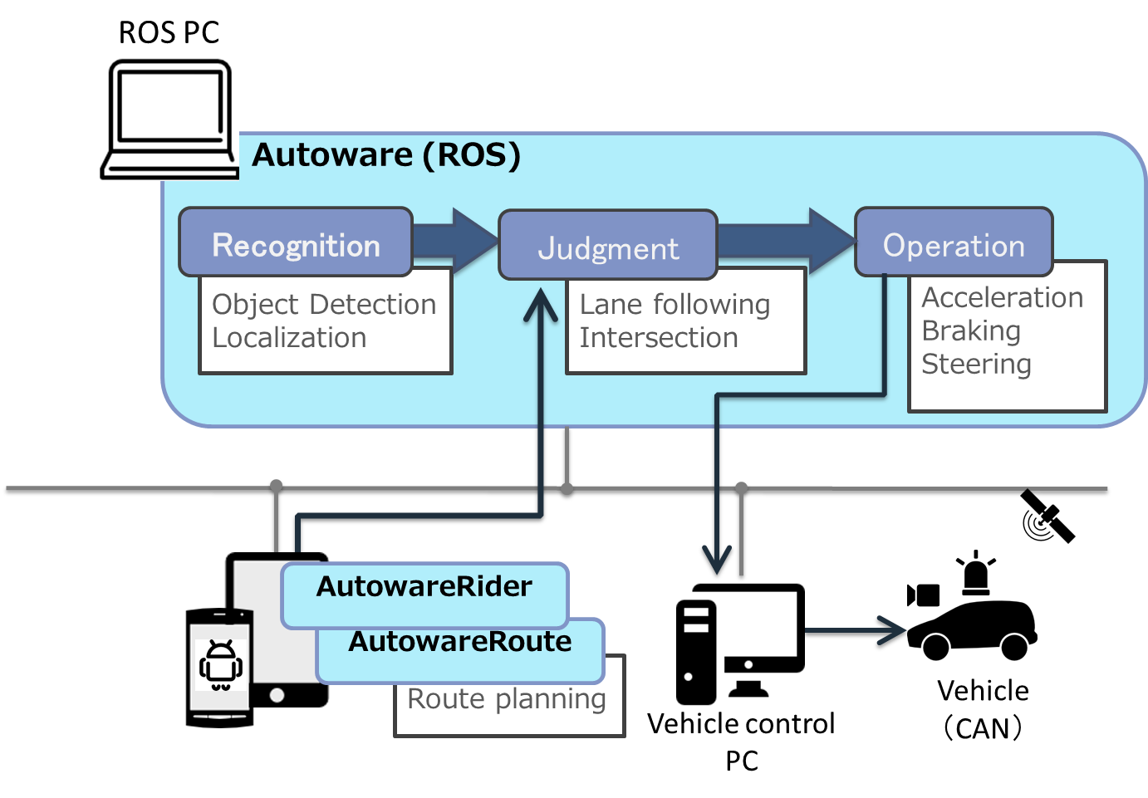
Autoware
Open-source AD platform from Japan.
Autoware.AI (https://www.autoware.ai) is based on ROS-1
Autoware.auto (https://www.autoware.auto) is the new version based on ROS2

Slide 26
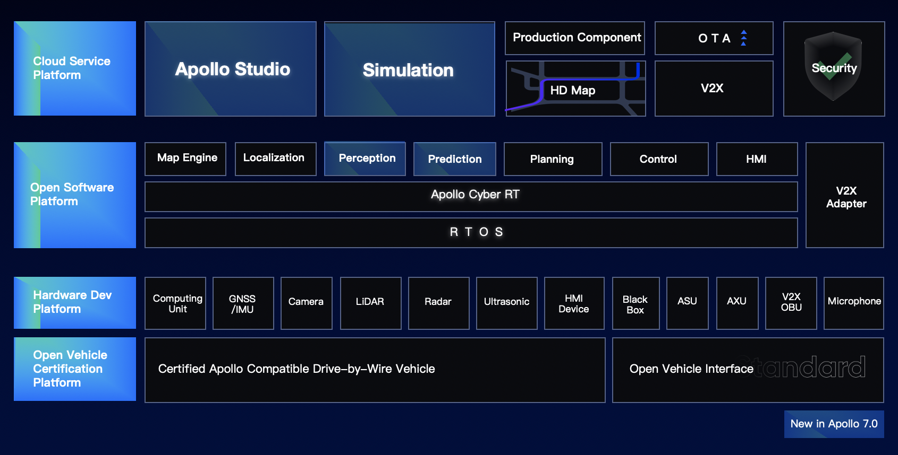
Baidu Apollo
An open-source, hardware-neutral AD platform from China
Initially based on ROS, but later replaced ROS with their own components
Real-Time OS: Linux kernel with real-time patch
Cyber RT: lightweight, high-performance communication middleware

Slide 27
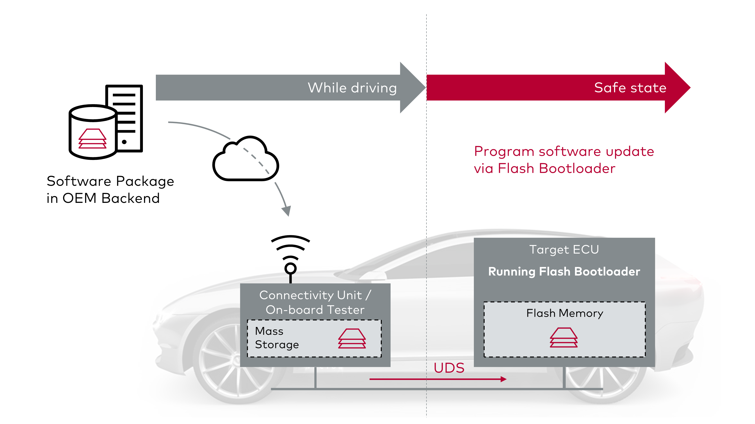
Over-The-Air (OTA) Update w. Connectivity ECU
Flash Bootloaders are small programs used to erase and rewrite the flash memory, for programming an ECU or updating it later in its life cycle
The new version of software is transferred wirelessly to the vehicle and temporarily stored on a "Connectivity ECU", with sufficiently large memory. When in a safe state, the connectivity ECU starts the update process and loads the software update to the target ECU via a diagnostic sequence - just as the service shop diagnostic tester would do
During the update process, the vehicle remains in a safe state and cannot be used
The ECUs involved in the update process must be supplied with power. The remaining capacity of the battery limits duration of the update
https://www.vector.com/se/en/products/application-areas/embedded-software/embedded-trends/ota-update-approaches/

Slide 28
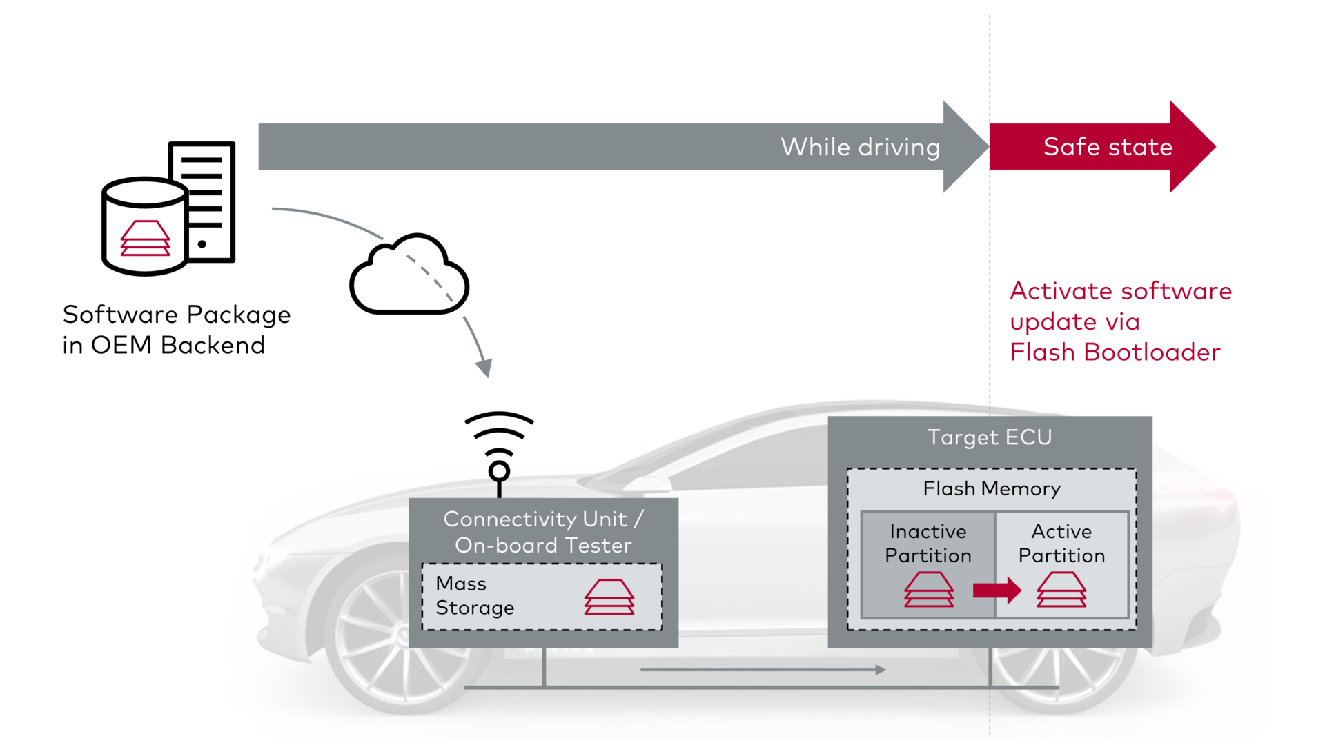
OTA Update w/o Connectivity ECU
New version of software is directly transferred to the target during normal operation, i.e. while the vehicle is in motion, with storage in a memory area separate from the driving application.
Advantages:
No need for transfer of the update from Connectivity ECU to the target ECU in the safe vehicle state; the vehicle remains ready for operation at all times despite software updates
Restoring the previous software is possible without further data transmission
https://www.vector.com/se/en/products/application-areas/embedded-software/embedded-trends/ota-update-approaches/

Slide 29
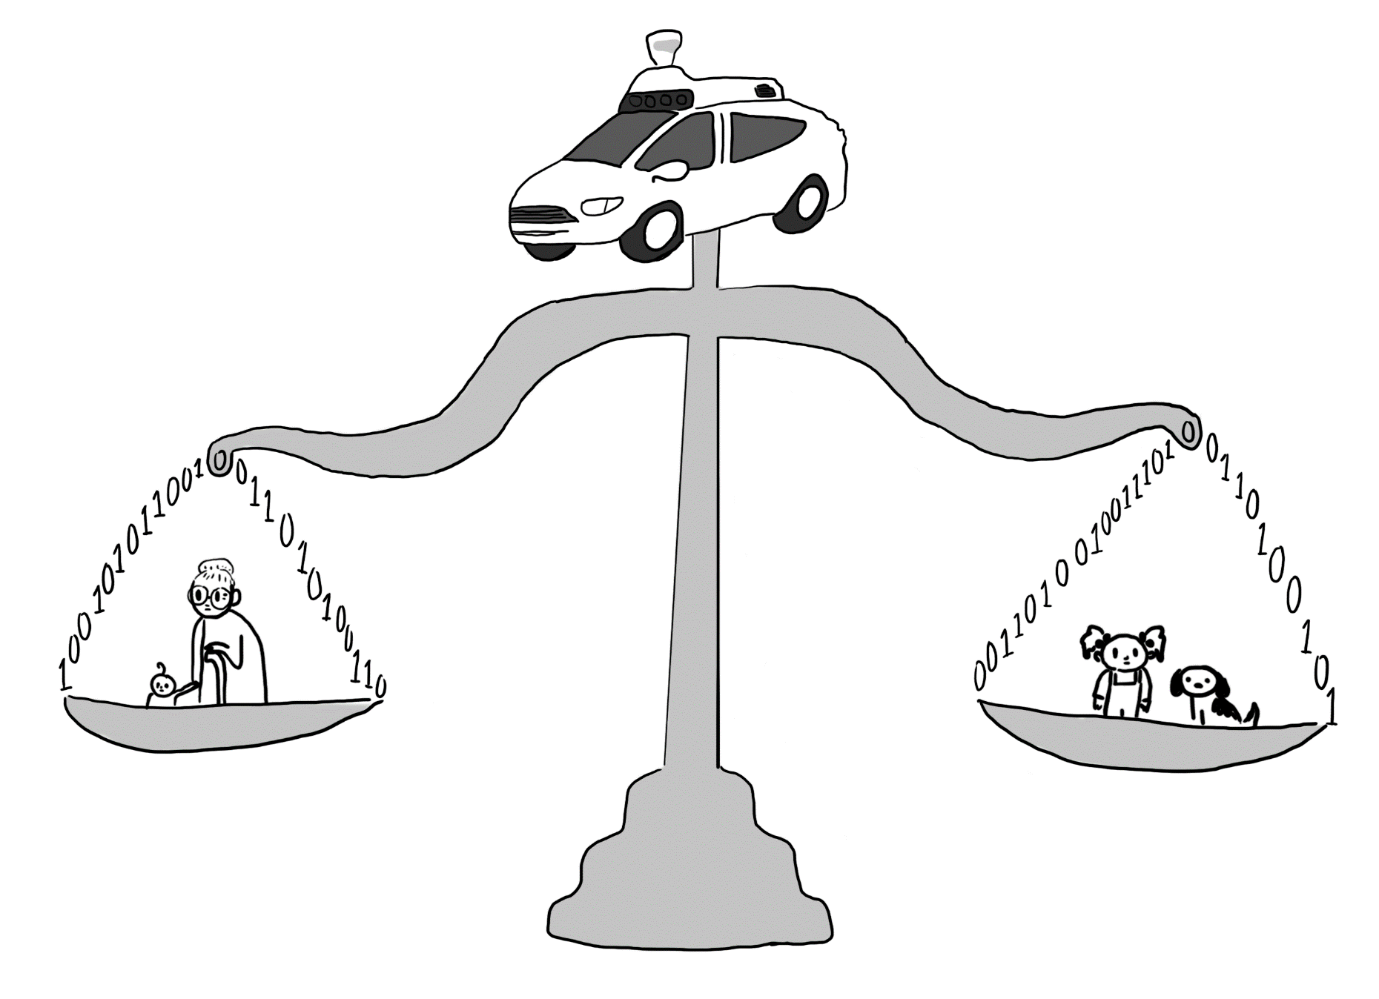
Ethical Issues

Slide 30
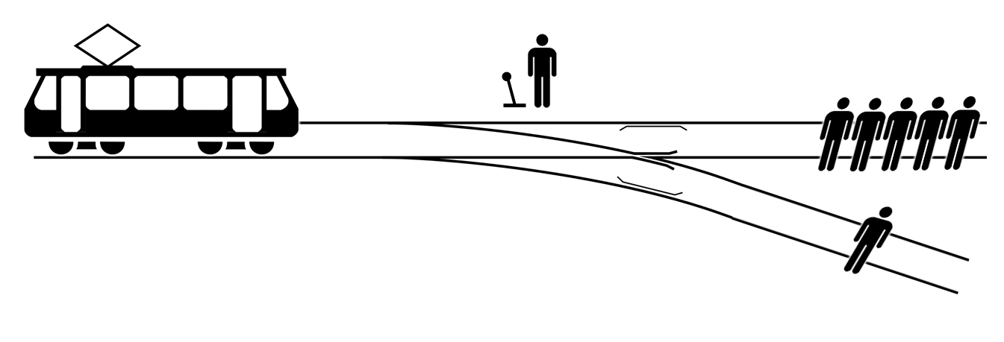
The Trolley Problem
There is a runaway trolley barreling down the railway tracks. Ahead, on the tracks, there are five people tied up and unable to move. The trolley is headed straight for them. You are standing some distance off in the train yard, next to a lever. If you pull this lever, the trolley will switch to a different set of tracks. However, you notice that there is one person on the side track. You have two options:
Do nothing and allow the trolley to kill the five people on the main track.
Pull the lever, diverting the trolley onto the side track where it will kill one person.
What is the right thing to do?

Slide 31
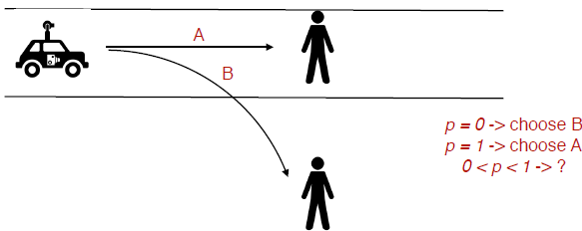
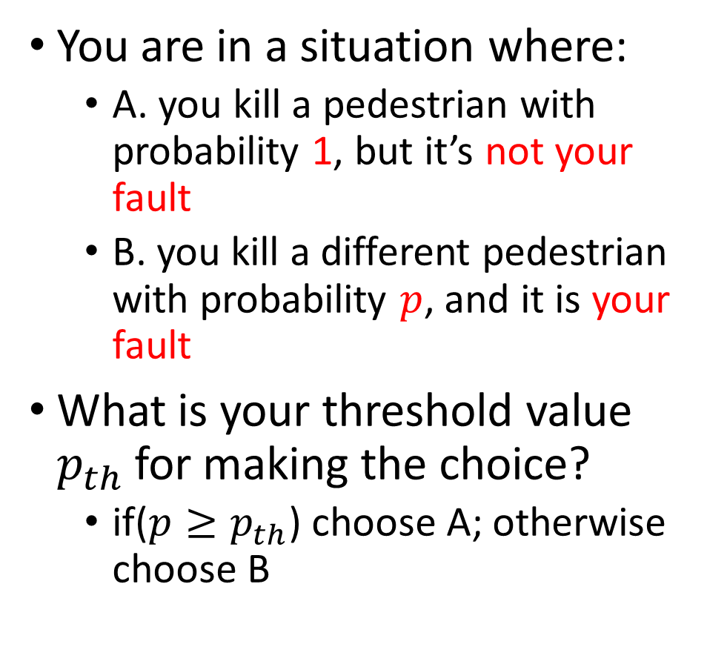
Variant of Trolley Problem with a Probability Threshold
You are in a situation where:
A. you kill a pedestrian with probability 1, but it’s not your fault
B. you kill a different pedestrian with probability $p$, and it is your fault
What is your threshold value $p_{th}$for making the choice?
if($p≥p_{th}$) choose A; otherwise choose B
jaywalker
Pedestrian on sidewalk

Slide 32
MIT Moral Machine Experiment
A 2016 survey indicates that people wanted an autonomous vehicle to protect pedestrians even if it meant sacrificing its passengers — but also that they wouldn’t buy self-driving vehicles programmed to act this way. This prompted the MIT Moral Machine Experiment, a platform for gathering a human perspective on moral decisions made by machine intelligence (http://moralmachine.mit.edu/)
One scenario: an AV must choose between killing two passengers or five pedestrians. An AV experiences a sudden brake failure. Staying on course would result in the death of two elderly men and an elderly woman who are crossing on a ‘do not cross’ signal (left). Swerving would result in the death of three passengers: an adult man, an adult woman, and a boy (right)
You can also design other scenarios. Accident scenarios are generated with nine factors: sparing humans (versus pets), staying on course (versus swerving), sparing passengers (versus pedestrians), sparing more lives (versus fewer lives), sparing men (versus women), sparing the young (versus the elderly), sparing pedestrians who cross legally (versus jaywalking), sparing the fit (versus the less fit), and sparing those with higher social status (versus lower social status)
This platform gathered 40 million decisions in ten languages from millions of people in 233 countries
Moral Machines: How culture changes values
https://www.youtube.com/watch?v=jPo6bby-Fcg

Slide 33
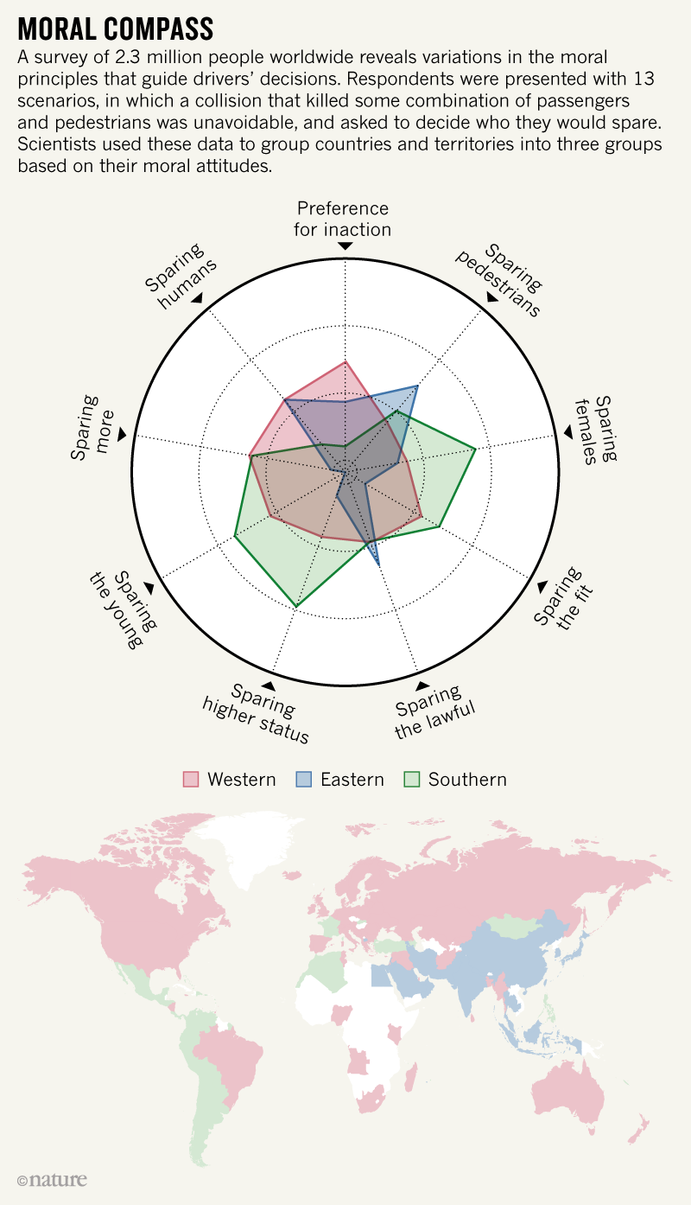
Cultural Clusters
Three large clusters
Western: Protestant, Catholic, and Orthodox countries in Europe and North America
Eastern: Islamic and Confucian (Asian) cultures
Southern: Central and South America, as well as France and former French colonies
The preference to spare younger characters rather than older characters is much less pronounced for countries in the Eastern cluster, and much higher for countries in the Southern cluster.
The same is true for the preference for sparing higher status characters.
Countries in the Southern cluster exhibit a much weaker preference for sparing humans over pets, compared to the other two clusters.
Only the (weak) preference for sparing pedestrians over passengers and the (moderate) preference for sparing the lawful over the unlawful appear to be

Slide 34
AV Ethical Issues: is it Worth the Time?
Many argue that ethical issues are just a distraction from the real problem of AV safety and security, esp. in the presence of ML/DL algorithms.
None of the AV accidents in recent years involved any ethical decisions similar to the Trolley Problem. They are due to failures in sensors or perception algorithms.
Sebastian Thrun (former head of Google’s SDC project, former professor at Stanford who led the development of Stanley, winner of DARPA Grant Challenge in 2005):
“I think it’s a great thing for philosophers to discuss these kind of problems. They can get tenure at their universities, but it's not of practical relevance. If we manage with certain car technology to halve the traffic deaths in the world, which means if we are able to have 500,000 fewer deaths in total, then for this extremely rare, purely hypothetical trolley problem that might occur once in a hundred years. I think whatever the outcome is, the mental energy that philosophers have spent on discussing it is completely out of proportion to the benefit of others on one problem. I will leave it at that.”

Slide 35
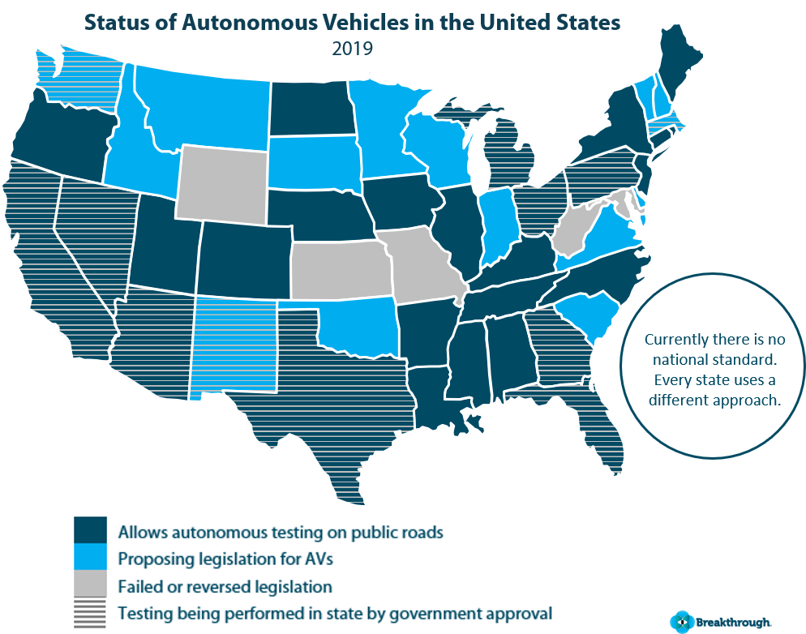
AV Testing Legislation (USA)
It is necessary to test AVs on public roads for technology development, but is it ethical?
Legislation regulating AV testing differs widely across states. Several states have no proposed legislation, meanwhile states like Nevada, California, Texas, and Arizona are hotbeds for testing AVs (partly due to sunny weather)

